Slide 1


Optimizing Inventory Management
IITM BDM PROJECT
A Primary Data Analysis for a Kitchen Appliances Retailer.
Presented by - Yash Karsh
Roll no. - 22f3002322

Slide 2
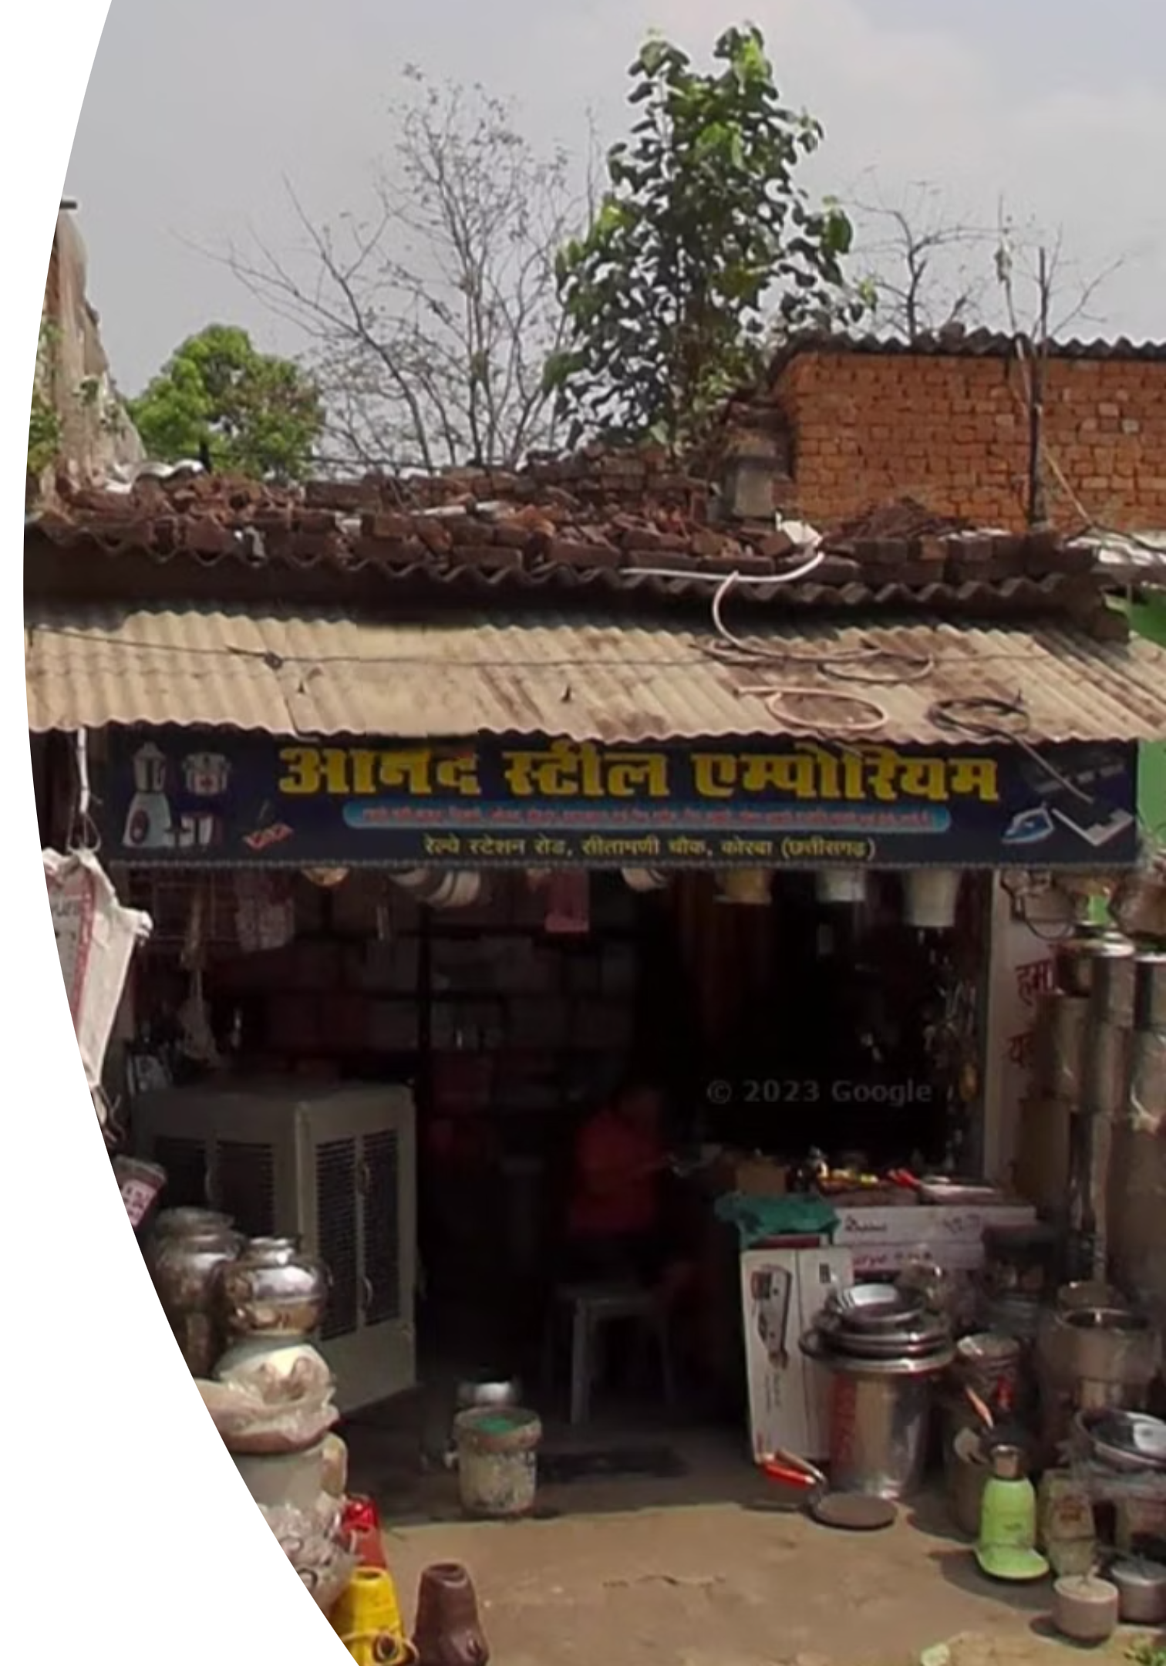
Organization Background
Anand Steel Emporium is a kitchen appliances retail shop located in Korba, Chhattisgarh. Established in 2010, it is owned and operated by Mr. Anand Sahu, employing 2 full-time staff.
The shop specialises in products such as pressure cookers, induction cooktops, and mixer grinders, serving a loyal customer base in the region.
The business operates 7 days a week, generating an estimated annual income of ₹35–40 lakh.
The Challenge
Our Approach
Stockouts, overstocking, and capital tied in unsold inventory.
Primary data analysis (300 restocking, 1,000 sales records) from 2023-2025.

Slide 3
Identifying Key Challenges: Problem Statements
1. Inventory Management Inefficiencies
2. Lack of Customer Preference Insights
3. Absence of Data Driven Insights
Anand Steel Emporium faced challenges in optimal stock levels, leading to:
Absence of granular data on customer buying patterns meant:
Reliance on traditional methods instead of data analysis led to:
Overstocking of slow-moving items, tying up capital.
Difficulty in prioritizing products for procurement and marketing.
Suboptimal decision-making in purchasing and sales.
Understocking of high-demand products, resulting in lost sales.
Limited ability to forecast demand accurately.
Missed opportunities for targeted sales strategies.
Missed opportunities for competitive advantage.
Inefficient product placement and promotions.
Suboptimal warehouse space utilization.

Slide 4

Analysis Process & Methods
Our analysis involved meticulous data cleaning and the application of several key methodologies to derive actionable insights.
1
2
3
Data Collection
Data Cleaning
ABC Analysis
We compiled over 300 restocking records and 1,000 sales transactions , spanning January 2023 to March 2025.
Standardized dates, merged product names, removed duplicates and invalid entries.
Prioritized products by Annual Consumption Value (ACV) to classify critical items.
4
5
6
Trend Identification
Pareto Analysis
RFM Analysis
Identified patterns and seasonality in purchases and sales over time.
Confirmed product concentration (80/20 rule) for sales volume and value.
Segmented products by Recency, Frequency, and Monetary value to understand customer preference.

Slide 5
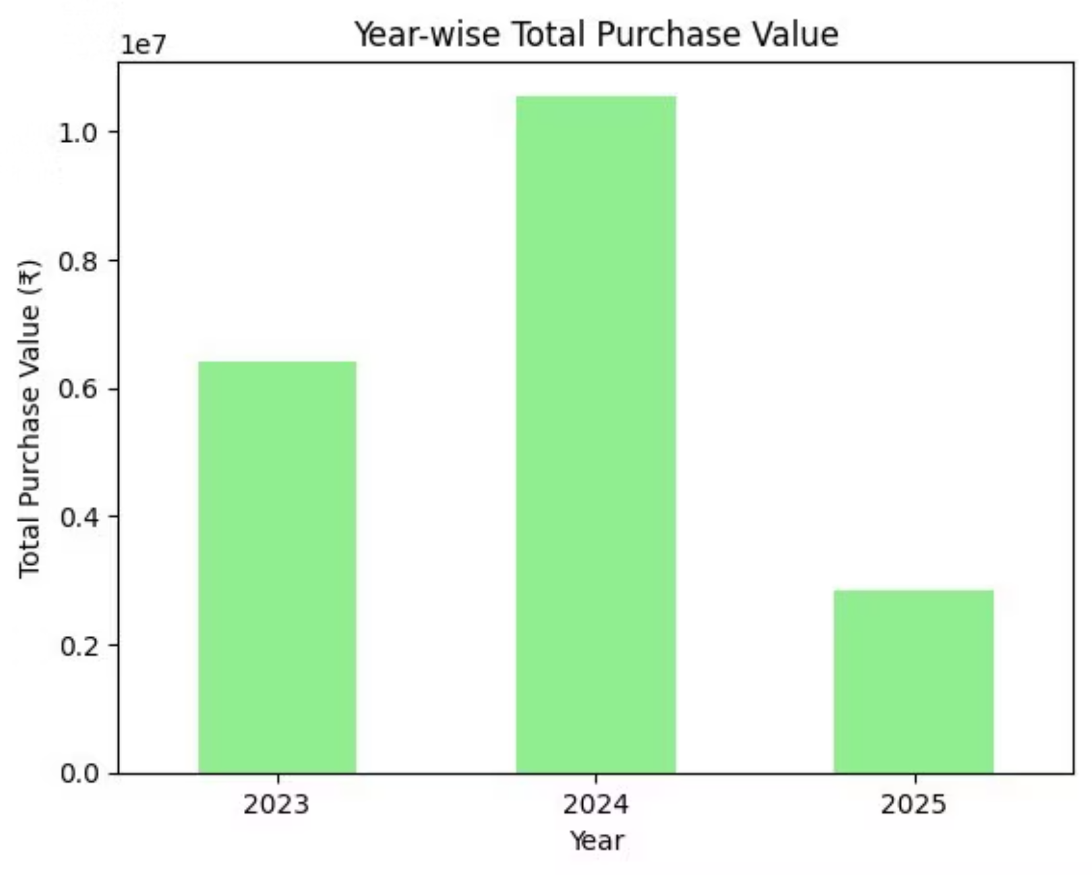
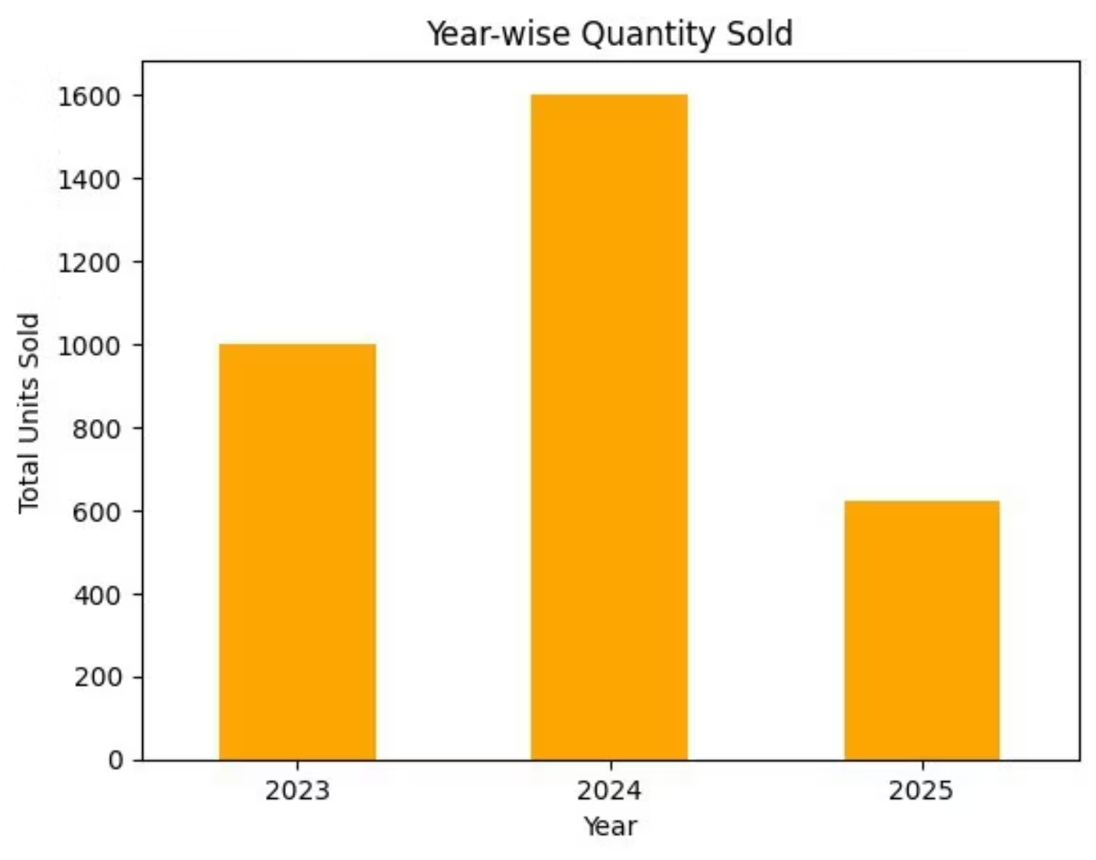
Year-wise Summary Trends
Purchase value peaked in 2024, exceeding ₹1 crore. This was followed by a sharp decline to under ₹30 lakhs in 2025, potentially indicating a significant slowdown in procurement or an accumulation of excess inventory.
Similarly, 2024 showed the highest purchase quantity, with approximately 1,600 units acquired. This trend aligns with the increased purchase value observed for the same period.

Slide 6
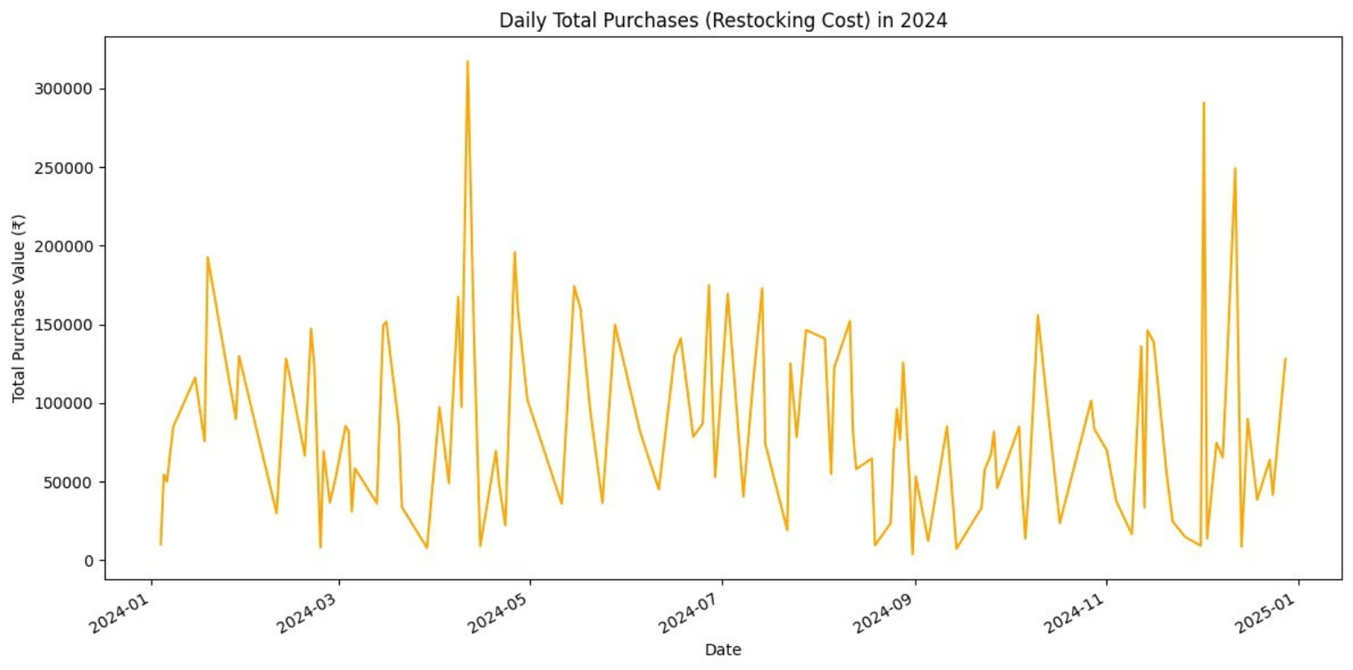
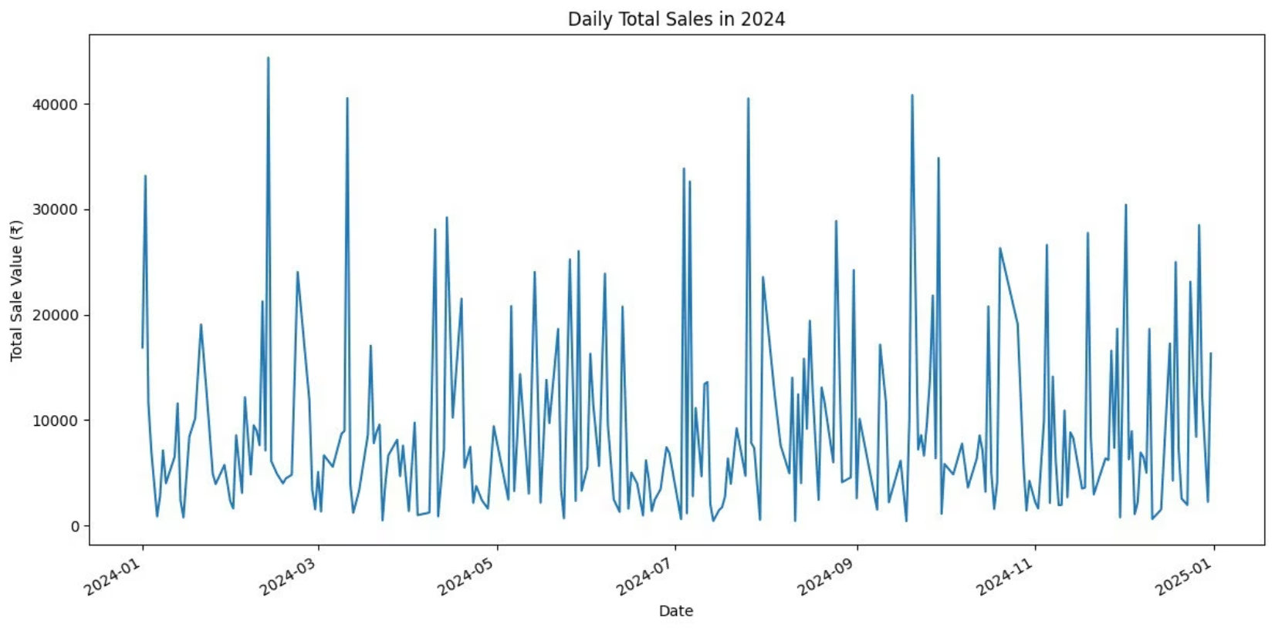
Daily Restocking & Sales Patterns
Restocking Volatility
Sales Fluctuations
Daily purchases in 2024 showed high volatility with multiple spikes, peaking above ₹3 lakhs. This indicates reactive procurement, possibly driven by stockouts or seasonal demand, rather than systematic planning.
Daily sales activity in 2024 exhibited substantial day-to-day fluctuations, peaking around ₹45,000 on some days and dipping below ₹5,000 on others. This highlights uneven demand distribution.

Slide 7
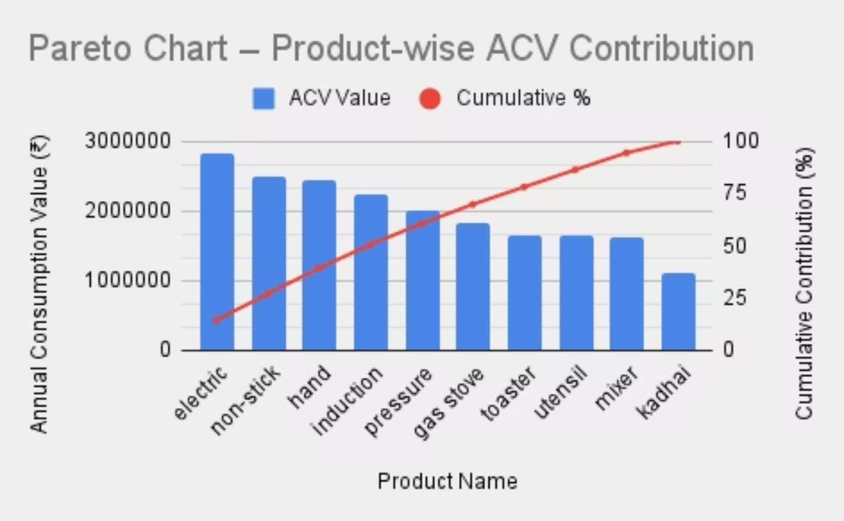
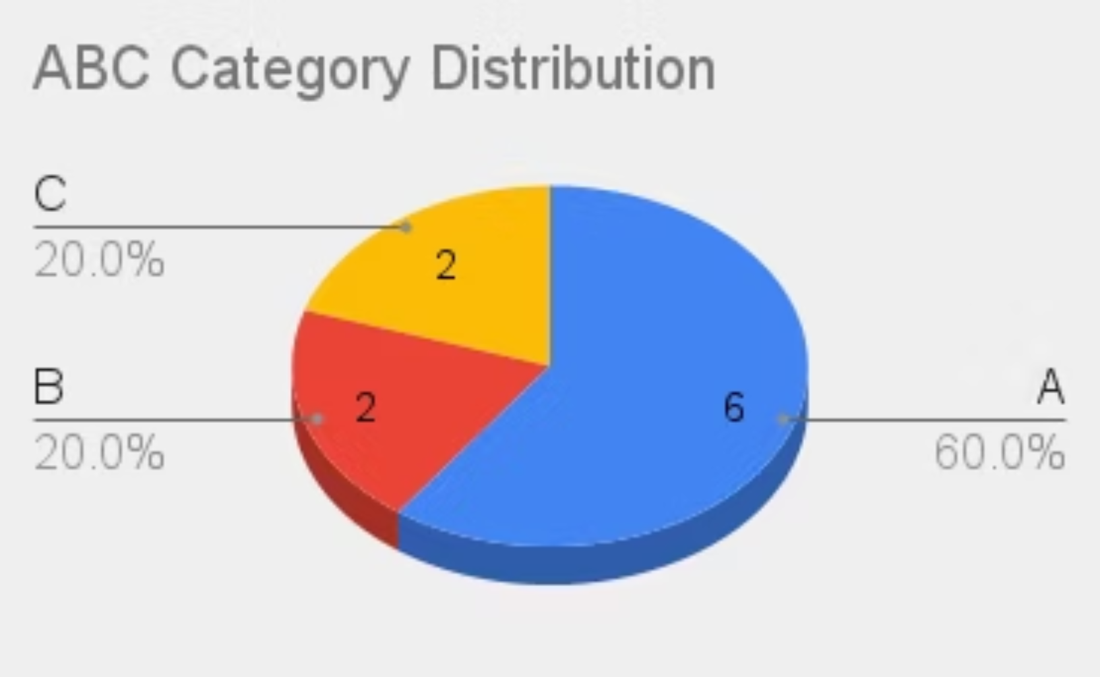
ABC Classification: Product Contribution
ACV Contribution
Category Distribution
The top 3 products (electric kettle, non-stick, hand blender) contribute over 50% of overall ACV. The top 6 items reach the 80% cumulative threshold, classifying them as 'A' category—strategic and high-value.
Category A comprises 60% of items, indicating a significant portion of inventory is high-value and requires close monitoring. Categories B and C represent 20% each, requiring less rigorous management.

Slide 8
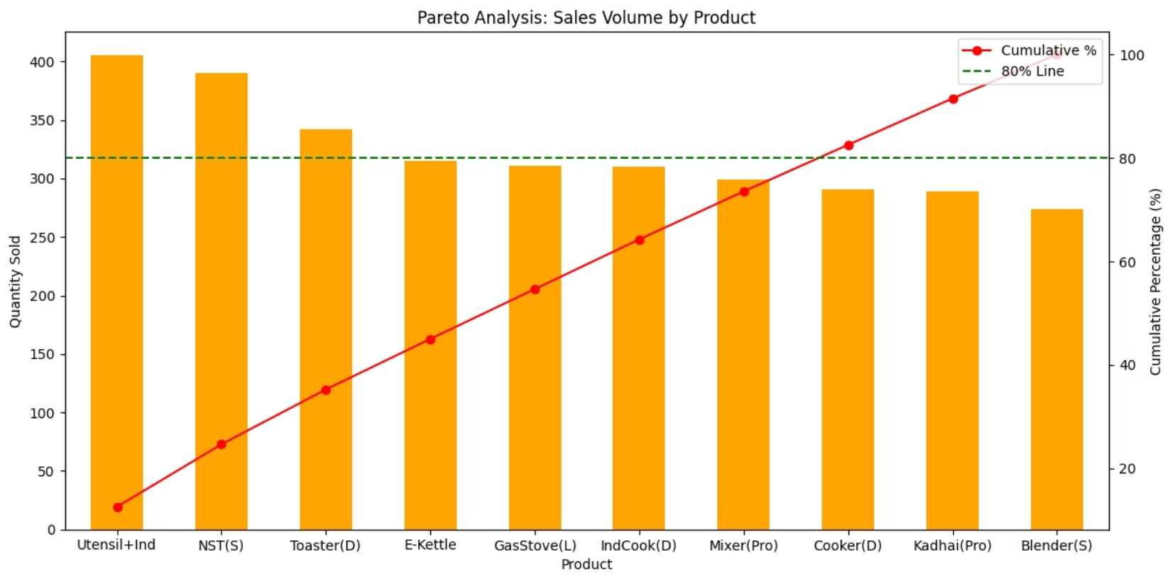
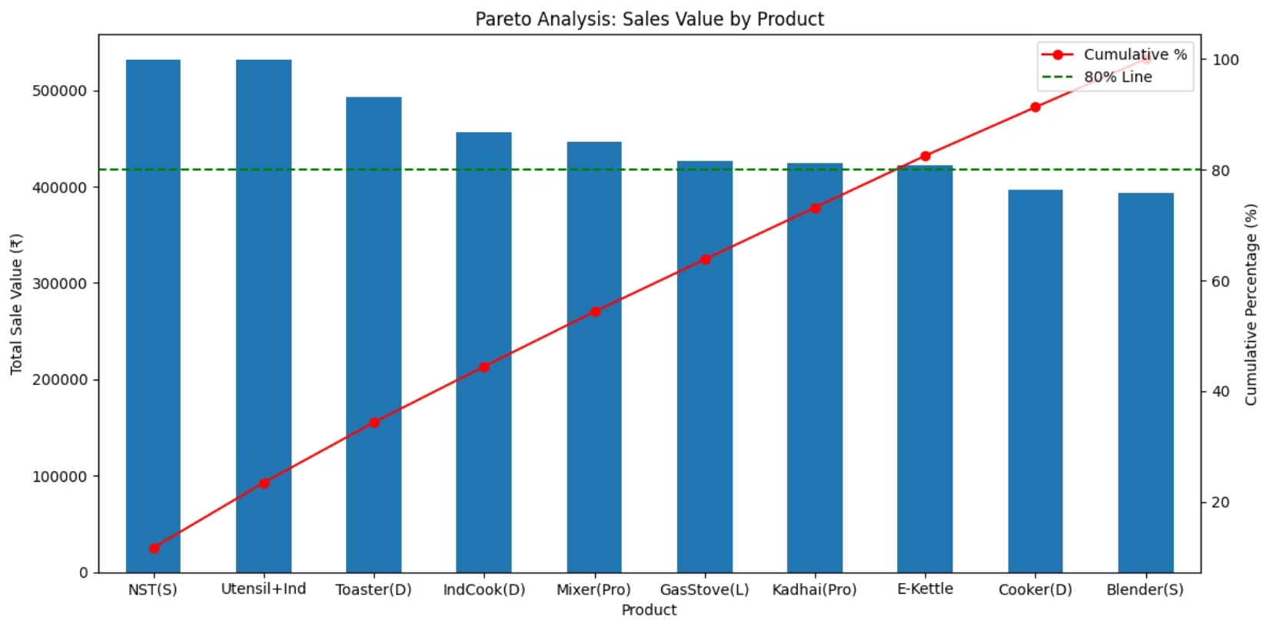
Pareto Analysis: Sales Concentration
Sales Volume
Sales Value
A few products like utensils, non-stick tawas, and toasters dominate sales volume. The top 6 products account for roughly 80% of total sales, reinforcing the classic Pareto rule.
Non-stick tawas and mixer grinders lead in total sales value, indicating higher price points and profitability. 6–7 items generate around 80% of revenue, highlighting product pricing impact.

Slide 9
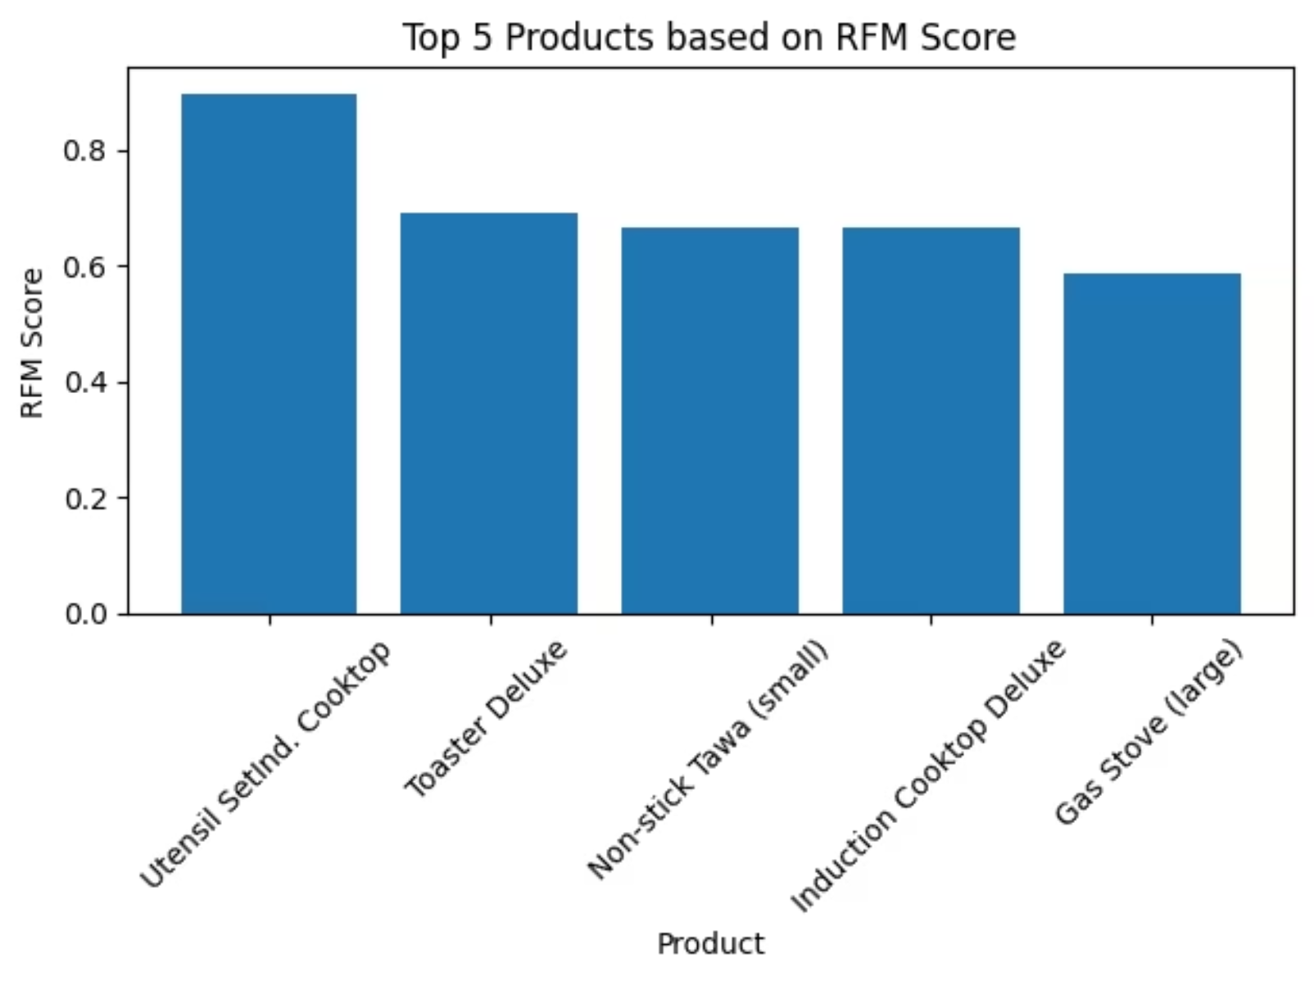
RFM Analysis: Product Preference
RFM analysis confirms that a limited set of products consistently drive customer preference and revenue.
RFM Score Distribution: Top 5 Products
Electric Kettle and Non-Stick Tawa are ranked first and second respectively, indicating that they are purchased most frequently, generate high monetary value, and have been sold very recently.
Consequently, these items should be prioritised in terms of stock availability, supplier negotiations and display planning.
Other high-scoring products include Induction Cooktops, Utensil Sets, and Mixer Grinders.
These results confirm that a limited set of products consistently drive both customer preference and revenue.
The bar graph clearly illustrates the superior RFM performance of the Electric Kettle and Non-Stick Tawa, emphasizing their critical role in customer engagement and sales. These products should be prioritized for inventory management and promotional activities.

Slide 10
Actionable Recommendations
Implement these SMART recommendations to optimize inventory management and drive sustainable growth.
ABC-based Replenishment
Weekly Stock Reviews
Phase Out C-Items
Conduct regular reviews to ensure smoother cash flow and optimized space.
Gradually reduce low-performing C-category inventory to free up capital.
Maintain 30-45 day stock for A-category items to reduce stockouts.
1
2
3
4
5
6
Digitize Inventory
Negotiate Bulk Discounts
Focus on High-RFM Products
Use Excel/Google Sheets for real-time tracking and demand estimation.
Secure better terms for fast-moving A-category items to improve margins.
Prioritize replenishment and display of top-performing items.

Slide 11

Implementation Impact
Adopting these recommendations will lead to significant improvements:
Reduced Stockouts
Improved Capital Turnover
Up to 30% reduction, ensuring key product availability.
Better utilization of funds by reducing blocked inventory.
Increased Revenue Consistency
Streamlined Restocking
Saving time and effort for the shopkeeper.
Focus on high-demand items for stable sales.

Slide 12

Thank You
Presented by Yash Karsh
We appreciate your time and interest.

